Slide 1
build
connect
disrupt

Slide 2
Building massively scalable IoT data pipelines with Azure Cosmos DB (ft. Toyota Service Connect)
TECH-DP305
Azure Cosmos DB team
#TECH-DP305

Slide 3
Confidentiality slide

Slide 4
Session objectives and takeaways
A brief recap of “What is Azure Cosmos DB?”
Understand the business goals and technical challenges faced by real-world customers w.r.t. IoT and databases
Learn why customers are choosing Azure Cosmos DB as the go-to database for IoT scenarios
Learn how to use Azure Cosmos DB to build a massively scalable IoT data pipeline

Slide 5
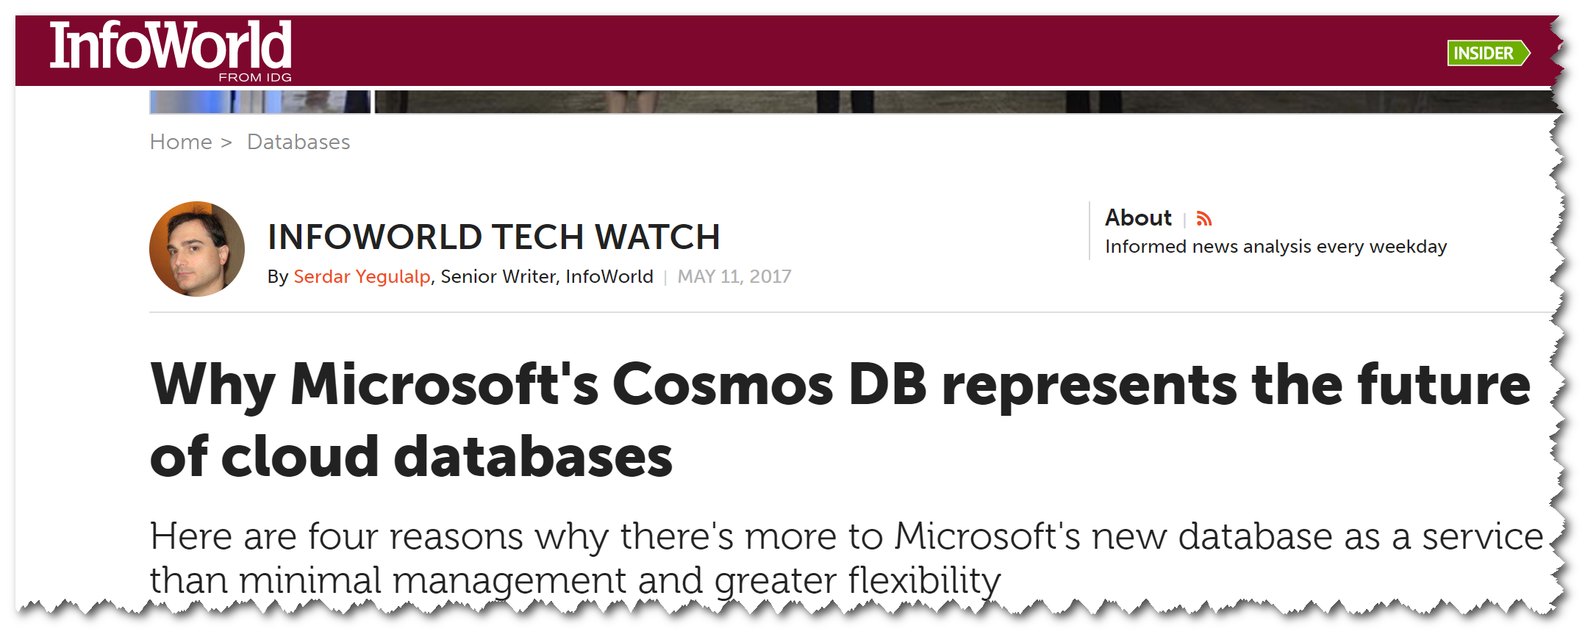
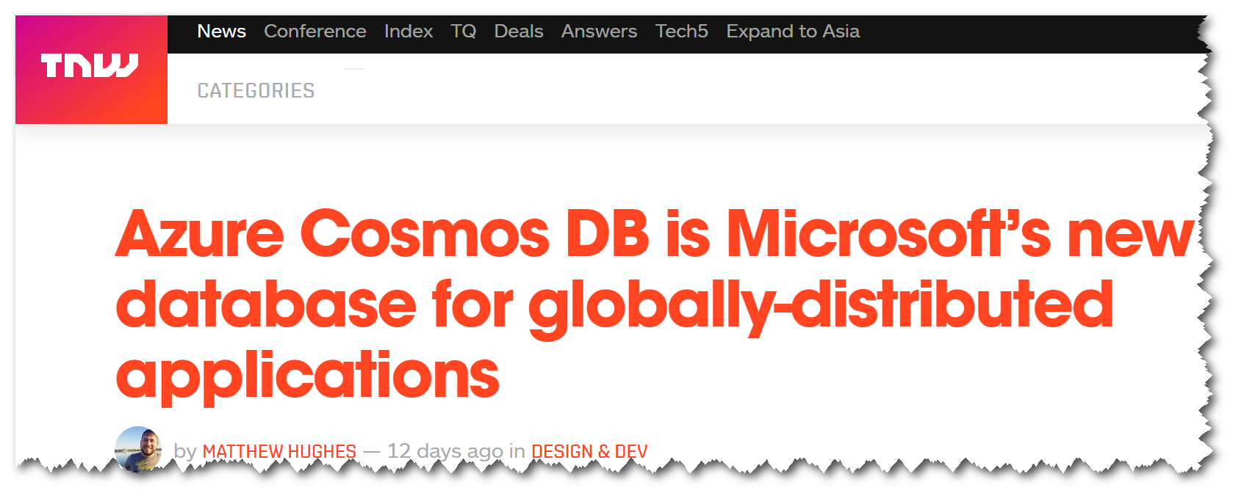
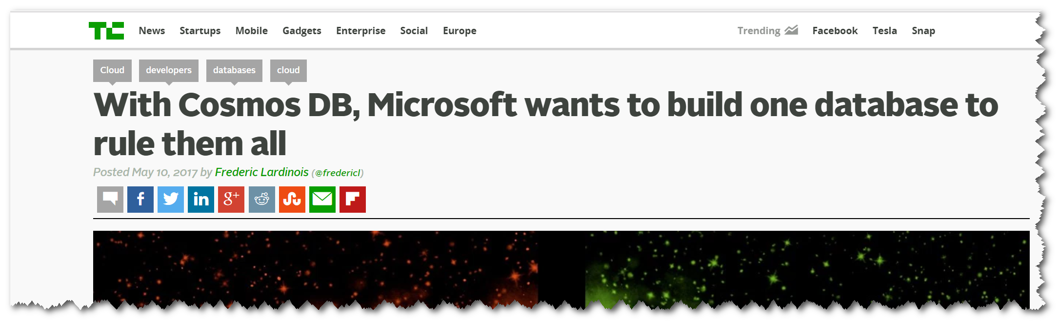
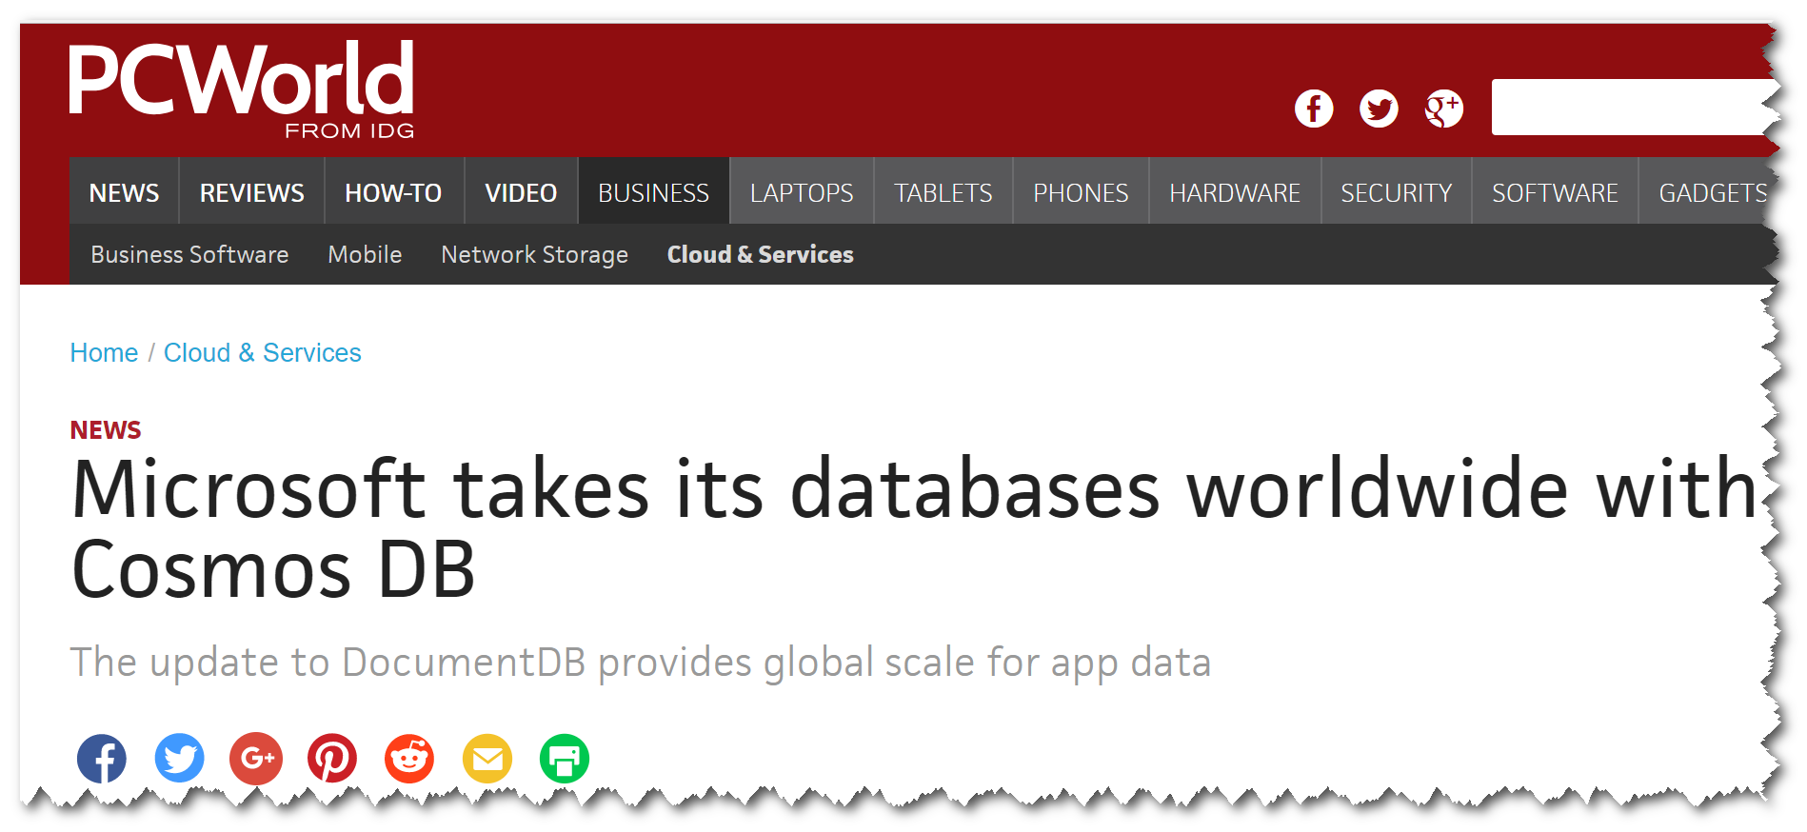
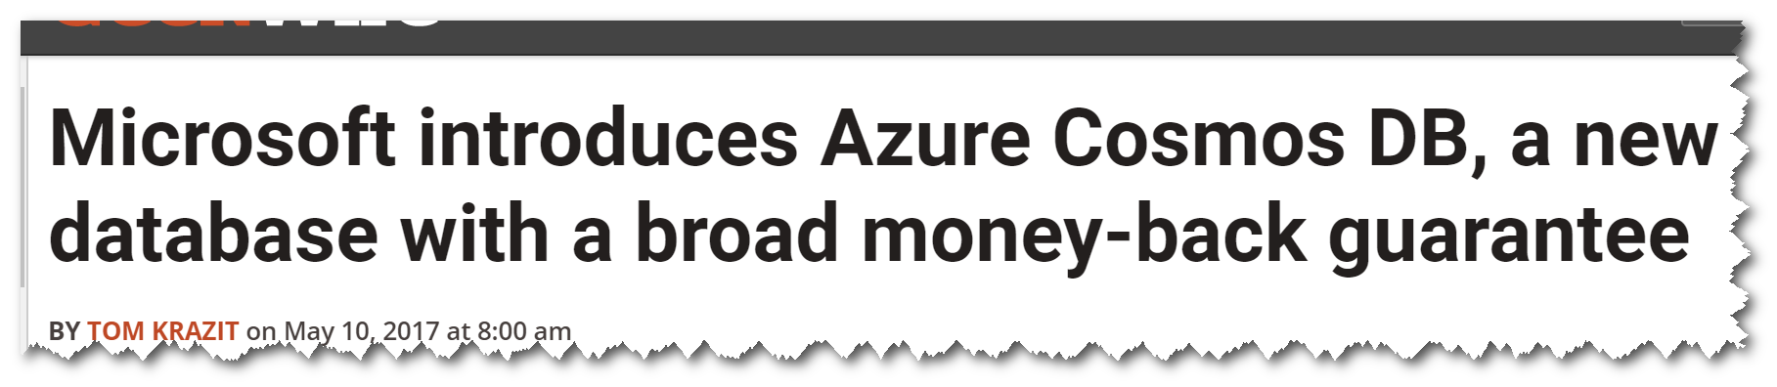

Slide 6



Azure Cosmos DB Evolution
Originally started to address the problems faced by large scale apps inside Microsoft
Built from the ground up for the cloud
Used extensively inside Microsoft
One of the fastest growing services on Azure
2010
2014
2015
2017
Project Florence
DocumentDB
Cosmos DB

Slide 7
Brief overview of Azure Cosmos DB

Slide 8
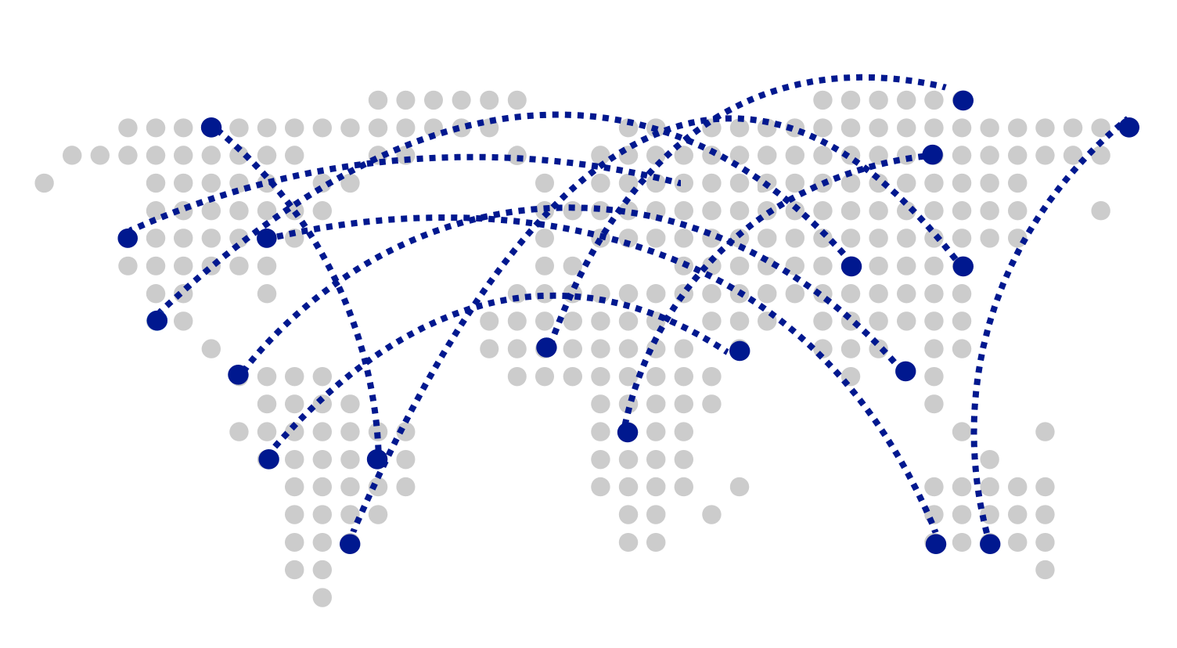
Turnkey Global Distribution
Worldwide presence as a Foundational Azure service
Automatic multi-region replication
Multi-homing APIs
Manual and automatic failovers
Designed for High Availability

Slide 9

Guaranteed low latency at P99 (99th percentile)
Requests are served from local region
Single-digit millisecond latency worldwide
Write optimized, latch-free database engine designed for SSD
Synchronous automatic indexing at sustained ingestion rates
Reads
(1KB)
Indexed writes
(1KB)
P50
<2ms
<6ms
P99
<10ms
<15ms

Slide 10
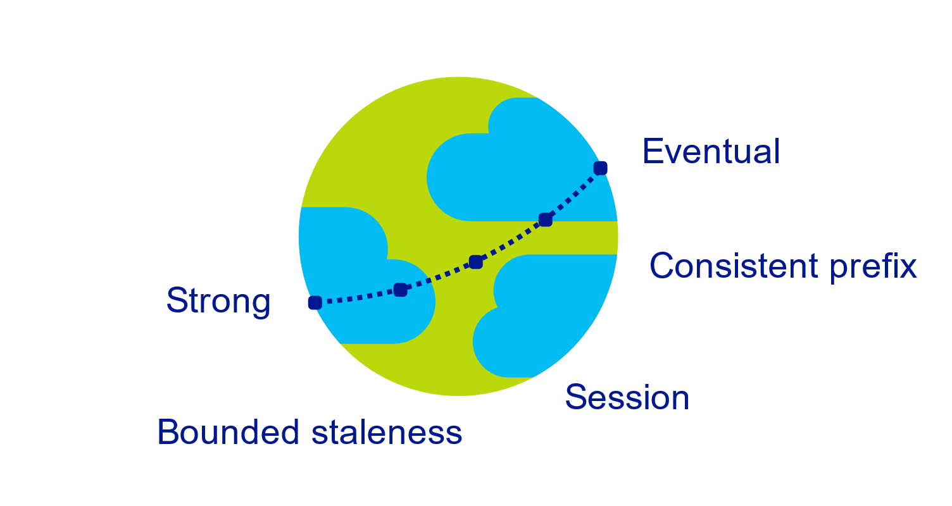
Multiple, well-defined consistency choices
Global distribution forces us to navigate the CAP theorem
Writing correct distributed applications is hard
Five well-defined consistency levels
Intuitive and practical with clear PACELC tradeoffs
Programmatically change at anytime
Can be overridden on a per-request basis

Slide 11

Elastically scalable storage and throughput
Single machine is never a bottle neck
Transparent server-side partition management
Elastically scale storage (GB to PB) and throughput (100 to 100M req/sec) across many machines and multiple regions
Automatic expiration via policy based TTL
Pay by the hour, change throughput at any time for only what you need
Support for both request per second and requests per minute to handle spikes cost-effectively
12000000
10000000
8000000
6000000
4000000
2000000
Black Friday
Provisioned request / sec
Nov 2016
Dec 2016
Time
Hourly throughput (request/sec)

Slide 12
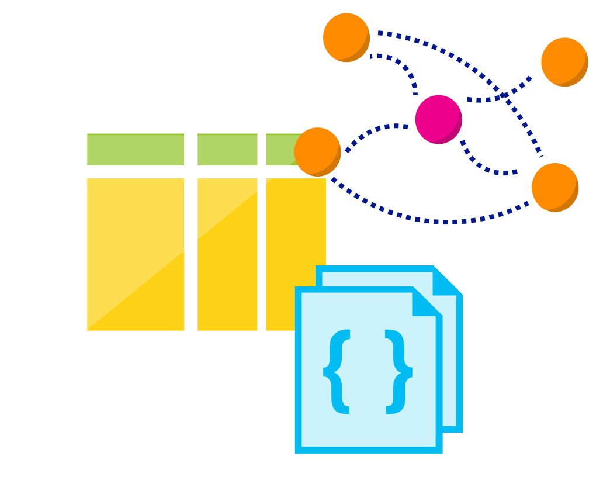
Multi-model, multi-API
Database engine operates on Atom-Record-Sequence type system
All data models can be efficiently translated to ARS
Multi-model: Key-value, Document, and Graph
Multi-API: SQL (DocumentDB), MongoDB, Table, and Gremlin
More data-models and APIs to be added

Slide 13
Schema-agnostic, automatic indexing
At global scale, schema/index management is painful
Automatic and synchronous indexing
Hash, range, and geospatial
Works across every data model
Highly write-optimized database engine
Schema
Physical index

Slide 14
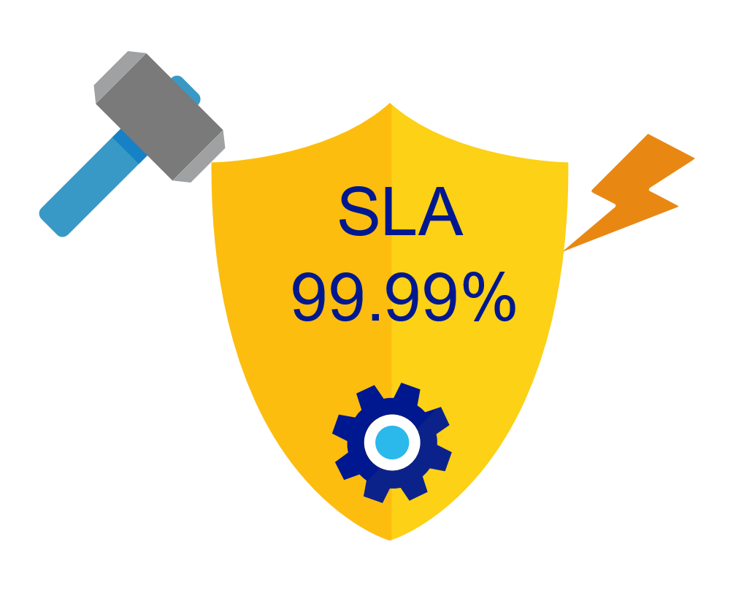
Industry-leading, enterprise-grade SLAs
99.99% availability – even with a single region
Made possible with highly-redundant storage architecture
Guaranteed durability – writes are majority quorum committed
First and only service to offer SLAs on:
Low-latency
Consistency
Throughput

Slide 15

Security & Compliance
Always encrypted at rest and in motion
Fine grained “row level” authorization
Network security with IP firewall rules
Comprehensive Azure compliance certification:
ISO 27001
ISO 27018
EUMC
HIPAA
PCI
SOC1 and SOC2

Slide 16
Lowest Total Cost of Ownership (TCO)
$
10x
Deeply exploit cloud core properties and economies of scale
Significantly cheaper than DynamoDB, Cassandra, Cloud Spanner and MongoDB
Designed from the ground up as a multi-tenant service with end-to-end resource governance to provide performance isolation.
Fully managed as a service - no dev/ops expenses needed
Cost
$
3x
Cosmos DB
DynamoDB
On-premises
MongoDB/
Cassandra

Slide 17
Let’s talk about IoT

Slide 18







Internet of Things - Database Needs
High scalability to ingest large # of events coming from many devices
Low latency queries and changes feeds for responding quickly to anomalies
Schema-agnostic storage and automatic indexing to support dynamic data coming from many different generations of devices
High availability across multiple data centers

Slide 19

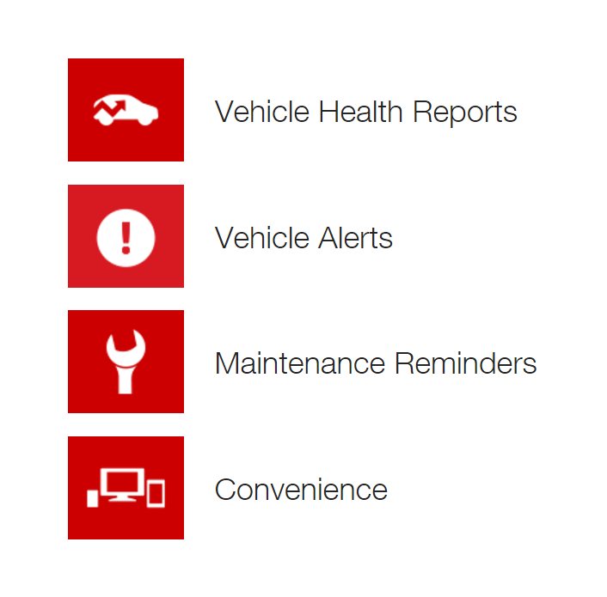
Toyota drives connected car push forward with:
Azure Cosmos DB and Apache Storm on HDInsight
Business need
Need to ingest massive volumes of diagnostic data from vehicles and take real-time actions as part of connected car platform
Management and operations of database infrastructure to handle exponential growth of data
Key benefits
DocumentDB can scale elastically without operational overhead of MongoDB
Perform fast queries over events to deliver safety, diagnostic, and remote services to Toyota customers

Slide 20









Real-Time Data Pipeline and Internet of Things
Aggregated + Archived Events (Cold)
pre-aggregates
Apache Storm on
Azure HDInsight
Azure Cosmos DB (Hot)
(telemetry and device state)
Azure IoT Hub
high-fidelity events
latest state
PowerBI
Azure Logic Apps
Azure Web Jobs
(Change feed processor)

Slide 21








… once data is captured – advanced analytics with Apache Spark connector
weather
global safety
alerts
Data Science Scenarios
Device
Notifications
Flight
information
Azure Cosmos DB
Web / REST API

Slide 22
Scale-out Computation
Spark SQL
Spark Streaming
GraphX (graph)
MLlib (machine learning)
Apache Spark on HDInsight
Scale-out Database
Spark Connector using DocumentDB API
Azure Cosmos DB

Slide 23
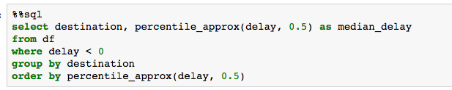
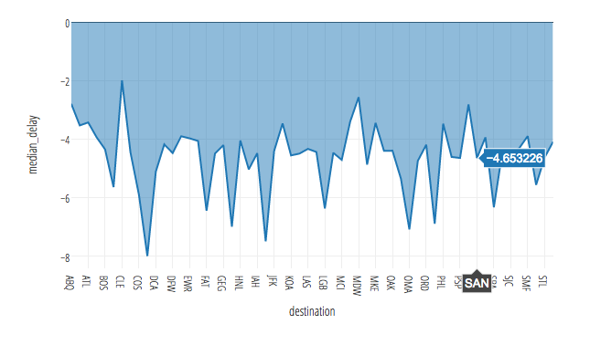
Spark connector for Azure Cosmos DB Distributed Aggregations and Analytics

Slide 24
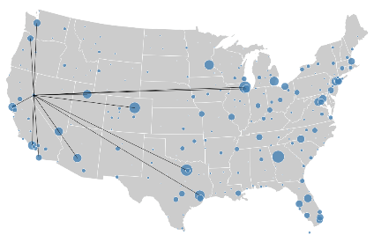
Spark connector for Azure Cosmos DB Pushdown Predicate Filtering
Data Science Scenarios
{city:SEA}
locations
headquarter
exports
0
1
{city:SEA, dst: POR, ...},
{city:SEA, dst: JFK, ...},
{city:SEA, dst: SFO, ...},
{city:SEA, dst: YVR, ...},
{city:SEA, dst: YUL, ...},
...
Belgium
0
1
country
city
country
city
city
city
Germany
Seattle
France
Paris
Moscow
Athens

Slide 25
Spark connector for Azure Cosmos DB Updateable Columns
Data Science Scenarios
{delay:-30}
{
tripid: “100100”,
delay: -5,
time: “01:00:01”
}
{
tripid: “100100”,
delay: -30,
time: “01:00:01”
}
{delay:-30}
Device
Notifications
Flight
information
Web / REST API
{delay:-30}

Slide 26
Azure Cosmos DB – a crash course

Slide 27
Account
Resource Model
Resources identified by their logical and stable URI
Hierarchical overlay over horizontally partitioned entities; spanning machines, clusters and regions
Extensible custom projections based on specific type of API interface
Stateless interaction (HTTP and TCP)
Database
Container
=
Collection
Graph
Table
Item

Slide 28
=
Horizontal Partitioning
Container
(partition-key = “airport”)
Collection
Graph
Table
Containers are horizontally partitioned
Each partition made highly available via a replica set
Partition management is transparent and highly responsive
Partitioning scheme is dictated by a “partition-key”
{ "airport" : "LAX" }
{ "airport" : "SYD" }
{ "airport" : “DUB" }
Replica set
…
Resource Partitions

Slide 29
Best Practices: Partitioning
All items with the same partition key will be stored in the same partition
Multiple partition keys may share the same partition using hash-based partitioning
Select a partition key which provides even distribution of storage and throughput (req/sec) at any given time to avoid storage and performance bottlenecks
Do not use current timestamp as partition key for write heavy workloads
"city" : “A-G"
"city" : “H-K"
"city" : “L-N"
"city" : “M-Z"

Slide 30
Best Practices: Partitioning
The service handles routing query requests to the right partition using the partition key
Partition key should be represented in the bulk of queries for read heavy scenarios to avoid excessive fan-out.
Partition key is the boundary for cross item transactions. Select a partition key which can be a transaction scope.
An ideal partition key enables you to use efficient queries and has sufficient cardinality to ensure solution is scalable
ACID
ACID
ACID

Slide 31
Container
=
Collection
Graph
Table
Global Distribution
…
All resources are horizontally partitioned and vertically distributed
Distribution can be within a cluster, x-cluster, x-DC or x-region
Replication topology is dynamic based on consistency level and network conditions
West US
…
Global Distribution
North Europe
…
Australia Southeast
Local Distribution

Slide 32
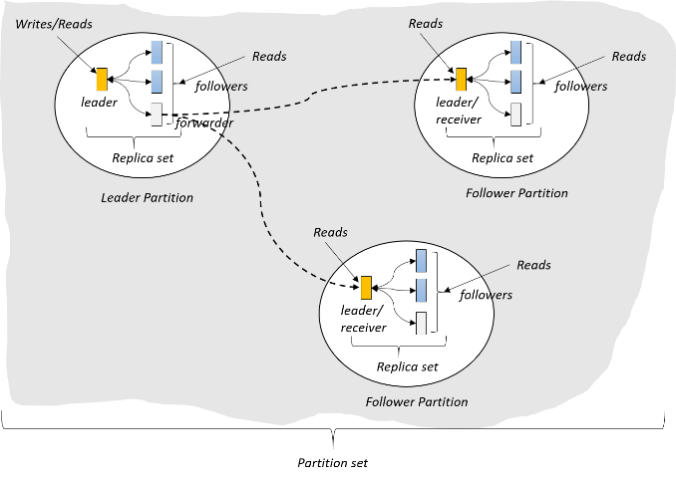
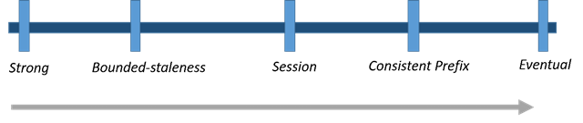
Consistency Levels
Strong, Bounded Staleness use quorum reads
Bounded staleness guarantees reads lag writes by < K prefixes
Session consistency offers read your writes; reads from up to date replica
Consistent prefix guarantees that reads never see out of order writes
Eventual from any replica

Slide 33
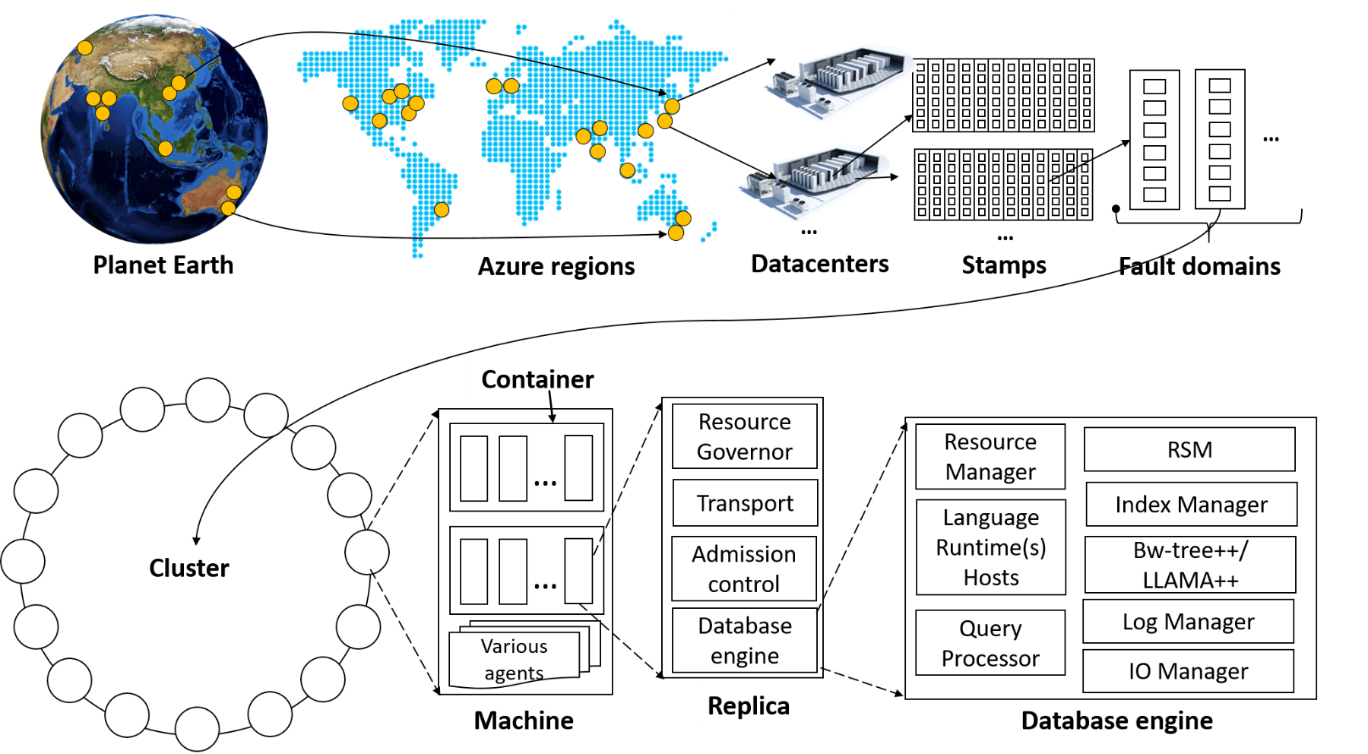
System topology (behind the scenes)

Slide 34
% CPU
Request Units
Request Units (RU) is a rate-based currency
Abstracts physical resources for performing requests
Key to multi-tenancy, SLAs, and COGS efficiency
Foreground and background activities
% Memory
% IOPS

Slide 35
GET
Request Units
Normalized across various access methods
1 RU = 1 read of 1 KB document
Each request consumes fixed RUs
Applies to reads, writes, queries, and stored procedure execution
POST
PUT
Query
…

Slide 36
Request Units
Provisioned in terms of RU/sec and RU/min granularities
Rate limiting based on amount of throughput provisioned
Can be increased or decreased instantaneously
Metered Hourly
Background processes like TTL expiration, index transformations scheduled when quiescent
Rate limit
Max RU/sec
No throttling
Incoming Requests
Min RU/sec
Replica
Quiescent

Slide 37
Demo: Let’s play with some code…

Slide 38
Azure Cosmos DB – In Summary

Slide 39



Internet of Things - Database Needs
Lots of seniors emitting telemetry => High rate of write ingestion
React quickly to anomalies => Low-latency queries and change feeds
Many different generations of devices => Different schemas

Slide 40





Azure Cosmos DB
A globally distributed, massively scalable, multi-model database service
Table API
MongoDB API
Column-family
Document
Key-value
Graph
Elastic scale out
of storage & throughput
Guaranteed low latency at the 99th percentile
Five well-defined consistency models
Turnkey global distribution
Comprehensive SLAs

Slide 41
In review: session objectives and takeaways
A brief recap of “What is Azure Cosmos DB?”
Understand the business goals and technical challenges faced by real-world customers w.r.t. IoT and databases
Learn why customers are choosing Azure Cosmos DB as the go-to database for IoT scenarios
Learn how to use Azure Cosmos DB to build a massively scalable IoT data pipeline

Slide 42



Session resources
askcosmosdb@microsoft
cosmosdb.com
Follow @AzureCosmosDB
Use #CosmosDB
#azure-cosmosdb

Slide 43
Related content
Come chat with our product team at our booth in the Expo!
More sessions on Azure Cosmos DB through the week:
(TECH-DP300) A lap around Azure Cosmos DB: Microsoft's globally distributed, multi-model database
Tuesday 1:45-2:45pm with Rimma Nehme
(SPEC-DP221) Bootcamp: Azure CosmosDB
Tuesday 3:15-4:15pm with Rimma Nehme
(TECH-DP302) Globally-Distributed Graph-as-a-service via Azure Cosmos DB
Tuesday 4:45-5:45pm with Aravind Krishna
(TECH-DP205) Globally-distributed Premium Azure Table experience using Cosmos DB
Wednesday 4-5pm with Govind Kanshi

Slide 44

Enjoy a session
Fill out an eval
Win a prize
Make MS Ready better
Evaluations can be submitted via
Laptop/Mobile connect to Schedule Builder on www.microsoftready.com
Windows/Windows Phone MS Ready App (Search “MS Ready” in the Store)
Your Mobile Device scan the QR code to reach your evals
*If you plan to remain in this room for the next session, please be sure to scan your badge again at the door prior to the session starting

Slide 45
Q&A
If you have questions please proceed to the Q&A MICROPHONE located in your session room.

